Slide 1
WEEK 2 LECTURES
Overview - Cellular concepts - Frequency reuse, Channel assignment- Hand off, Interference and system capacity
Syllabus Coverage:
Frequency reuse, sectored and omni- directional antennas, Channel assignment strategies, Handoff and its types, Interference and system capacity
Courtesy:
Rappaport T.S, “Wireless Communications: Principles and Practice”, Pearson education.

Slide 2
Cellular Systems-Basic Concepts
Cellular system solves the problem of spectral congestion.
Offers high capacity in limited spectrum.
High capacity is achieved by limiting the coverage area of each BS to a small geographical area called cell.
Replaces high powered transmitter with several low power transmitters.
Each BS is allocated a portion of total channels and nearby cells are allocated completely different channels.
All available channels are allocated to small no of neighboring BS.
Interference between neighboring BSs is minimized by allocating different channels.

Slide 3
Cellular Systems-Basic Concepts
Same frequencies are reused by spatially separated BSs.
Interference between co-channels stations is kept below acceptable level.
Additional radio capacity is achieved.
Frequency Reuse-Fix no of channels serve an arbitrarily large no of subscribers

Slide 4
Cellular Concept
used by service providers to improve the efficiency of a cellular network and to serve millions of subscribers using a limited radio spectrum
After covering a certain distance a radio wave gets attenuated and the signal falls below a point where it can no longer be used or cause any interference
A transmitter transmitting in a specific frequency range will have only a limited coverage area
Beyond this coverage area, that frequency can be reused by another transmitter.
The entire network coverage area is divided into cells based on the principle of frequency reuse

Slide 5
Frequency Reuse
The design process of selecting and allocating channel groups for all of the cellular base stations within a system is called frequency reuse or frequency planning.
Cell labeled with same letter use the same set of frequencies.
Cell Shapes:
Circle, Square, Triangle and Hexagon.
Hexagonal cell shape is conceptual , in reality it is irregular in shape

Slide 6
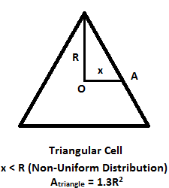
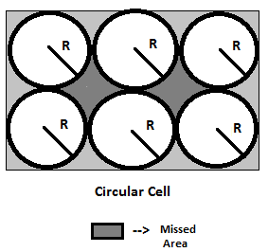
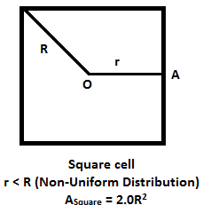
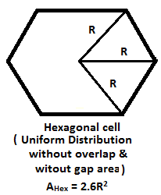
Frequency Reuse
Cell Geometry :

Slide 7
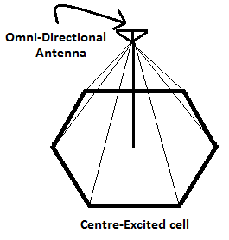
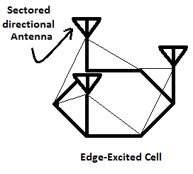
Frequency Reuse
Hexagonal cell shape is conceptual & is a simplistic model of radio coverage for each base station.
As the radiation from antenna is circular, thus there is fading on the edges of triangle & Square.
But in Hexagon shape, there is lesser fading on the edges.
When using hexagonal shaped cell, base station areas are depicted as either being in centre of cell i.e. Central Excited Cell or on the 3 edges of the 6 cell vertices i.e. Edge Excited Cell.
For Central Excited Cell, Omni-directional antennas are used.
For Edge Excited Cell, Sectored-directional antennas are used.

Slide 8
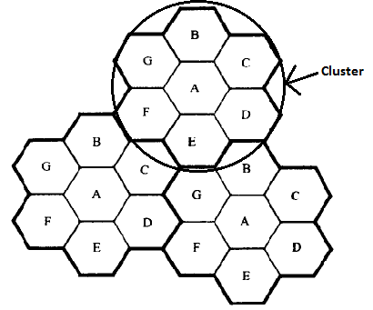
Frequency Reuse
The design process of selecting & allocating channel groups for all the cellular base stations with in a system is called Frequency Reuse or Frequency Planning.
Frequency Reuse Distance : Minimum distance b/w co-channel cells required to keep co-channel interference below certain threshold.
Each cellular base station
is allocated a group of radio
channels to be used within
a small geographic area
called Cell.
Base station of adjacent cells
are assigned channel group
which contains completely
different channels than
neighboring cells.
If N cells which collectively use the complete set of available frequencies is called a cluster.
Source : Wireless Communications: Principles and Practice, Theodore S. Rappaport, pp 59.

Slide 9
Frequency Reuse
The base station antennas are designed to achieve the desired coverage within the particular cell.
By limiting the coverage of a cell, the same group of channels may be used to cover different cells that are separated from one- another by large distances enough to keep interference level within tolerable limit.
After how many cells two cells assigned the same frequency to use, frequency Reuse concepts is used.
Consider a cellular system which has a total of ‘S’ duplex channels (total no. of channels in a cluster).
If each cell is allocated a group of ‘K’ channels & if S channels are divided among N cells into unique & disjoint channel groups.
Total number of available radio channels in a cluster can be given as:
S = KN
If a cluster is replicated M times within a system, total number of duplex channel ‘C’ can be used as a measure of capacity & is given as:
C = MS
C= MKN
Capacity of a cellular system is directly proportional to number of times a cluster is replicated in a fixed service area.

Slide 10
Frequency Reuse
Factor ‘N’ 🡪 called cluster size.
let total number of channel allocated for a cluster is M = 395.
let N = 7 (N= number of cells in a cluster), it means 395/7 = 57 frequencies is possible an average per cell to characterizing the frequency reuse.
Frequency Reuse factor of a cellular system is = 1/N (since each cell within a cluster is only assigned 1/N of total available channels in the system)
N = Cluster size is given by : N = i² + j² + i.j (i & j are integers)
For i=1, j=1, then N = 3. i.e. one cluster has 3 cells.
N may be = 1, 3, 4, 7, 9, 12, 13, 16, 19 etc.
d = distance b/w centre of two adjacent cells, R = Radius of cell
D = Minimum distance b/w centre of cells that use same channels or frequency band (co-channels)
Frequency reuse distance: D² = 3R² (i² + j² + i.j)
D² = 3R² .N
D = (3N)^{1/2}. R or D/R = (3N)^{1/2}
As d = 3^{1/2} .R D/d = (N)^{1/2}

Slide 11
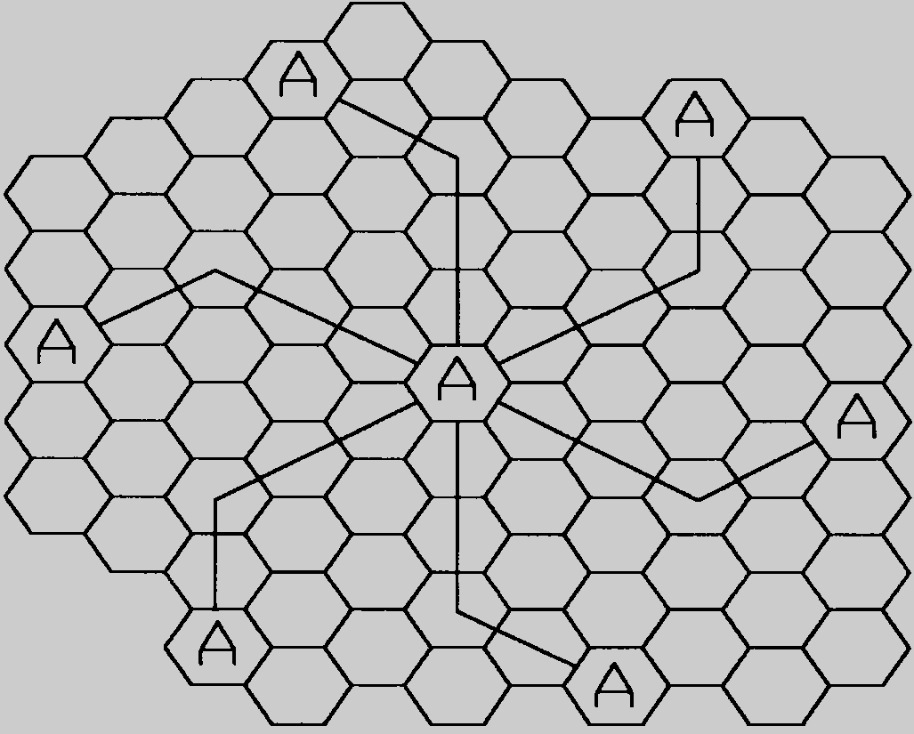
Locating co-channel Cell
To find the nearest co-channel neighbors of a particular cell, one must do the following:
a) Move i cells along any chain of hexagon.
b) Turn 60º counter clockwise & move j cells.
Figure 3.2 Method of locating co-channel cells in a cellular system.
In this example, N = 19 (i.e., i = 3, j = 2). (Adapted from [Oet83] © IEEE.)
Source : Wireless Communications: Principles and Practice, Theodore S. Rappaport, pp 60.

Slide 12
Effect of cluster size N
Channels unique in same cluster, repeated over clusters
Keep cell size same
large N : weaker interference, but lower capacity
small N: higher capacity, more interference ,need to
maintain certain S/I level
Frequency reuse factor: 1/N
each cell within a cluster assigned 1/N of the total
available channels
In most of the upcoming networks, frequency reuse
factor is 1.

Slide 13
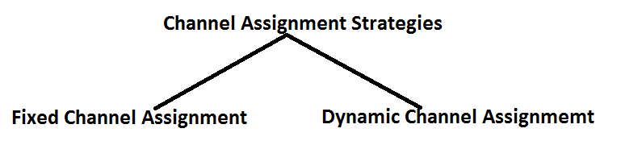
Channel Assignment Strategies (CAS)
Frequency reuse scheme
increases capacity
minimize interference
Fixed channel assignment
each cell is allocated a predetermined set of voice channel
any new call attempt can only be served by the unused channels
the call will be blocked if all channels in that cell are occupied
Dynamic channel assignment
channels are not allocated to cells permanently.
allocate channels based on request.
reduce the likelihood of blocking, increase capacity.

Slide 14
Fixed Channel Assignment Strategy (FCAS)
In FCAS each cell is assigned a predetermined set of voice channels
Any call attempt within the cell can only be served by the unused channel in that particular cell
If all the channels in the cell are occupied, the call is blocked. The user does not get service.
In variation of FCA, a cell can borrow channels from its neighboring cell if its own channels are full.

Slide 15
Dynamic Channel Assignment (DCA)
Voice channels are not allocated to different cells permanently.
Each time a call request is made, the BS request a channel from the MSC.
MSC allocates a channel to the requesting cell using an algorithm that takes into account
likelihood of future blocking
The reuse distance of the channel ( should not cause interference)
Other parameters like cost
DCA reduce the likelihood of blocking and increases capacity
Requires the MSC to collect realtime data on channel occupancy and traffic distribution on continous basis.
DCA is more complex (real time), but reduces likelihood of blocking

Slide 16
Handoff
When a mobile moves into a different cell while conversation is in progress, the MSC automatically transfers the call to a new channel belonging to new base station is known as Handoff.
Handoff operation not only involves identifying a new base station, but also requires that the voice & control signals be allocated to channels with the new base station.
Handoff must be performed successfully & as infrequently as possible.
For this system designer must specify an optimum signal level at which to initiate a handoff.
Once a particular signal level is specified as the minimum usable signal for acceptable voice quality at the base station receiver, a slightly stronger signal level is used as a threshold at which a handoff is made.
This margin (Threshold) is given by:
∆ = P_{r}(HANDOFF) - P_{r} (MIN. USABLE)

Slide 17
Handoff
∆ can’t be too large or too small.
Case 1: if ∆ is too large, unnecessary handoffs are there, which burden the MSC.
Case 2: if ∆ is too small, there may be insufficient time to complete a handoff before a call is lost due to weak signal conditions.
Call Drop event can happen:
Case 1: When there is an excessive delay by the MSC in assigning a handoff.
Excessive delay may occur during:
1) High traffic density, due to computational loading at the MSC
2) Due to the fact that no channels are available on any of the nearby base stations.
Case 2: When the threshold ∆ is set too small for the handoff time in the system.
Dwell Time : The time over which a call be maintained within a cell without handoff is called “Dwell Time”. (after the handoff threshold)

Slide 18
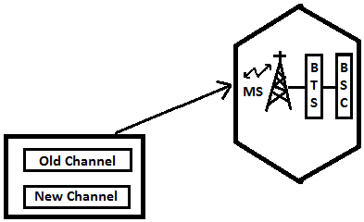
Types of Handoff
1) Intra-cell-Intra BSC Handover
2) Inter-cell-Intra BSC Handover
3) Inter-cell-Inter BSC Handover
4) Inter MSC Handover
Intra-cell-Intra BSC Handover : Smallest of the Handover is the intra-cell handover where the subscriber is handed over to another traffic channel (generally in another frequency) with in same cell.
In this case, BSC controlling the cell makes the decision to perform handover.

Slide 19
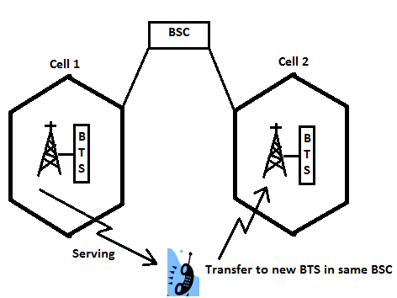
Types of Handoff
2) Inter-cell-Intra BSC Handover :
The subscriber moves from cell1 to cell 2 but within BSC.
In this case, the handover process is carried out by the BSC.
Traffic connection with cell 1 is released when the connection with cell 2 is setup successfully.

Slide 20
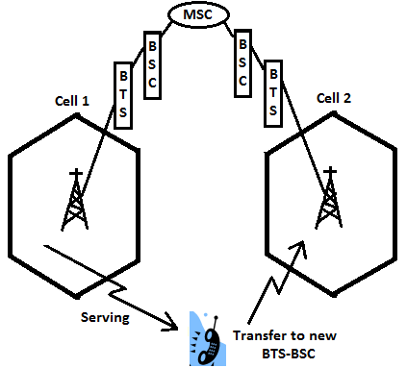
Types of Handoff
3) Inter-cell-Inter BSC Handover :
The subscriber moves from cell1 to cell 2 which is served by another BSC.
In this case, handover
process is carried out by
the MSC, but the decision
to make the handover is
still done by the first BSC.
Traffic connection
with the first BSC & BTS
is released when the
connection with the new
BSC & BTS is setup
successfully.

Slide 21
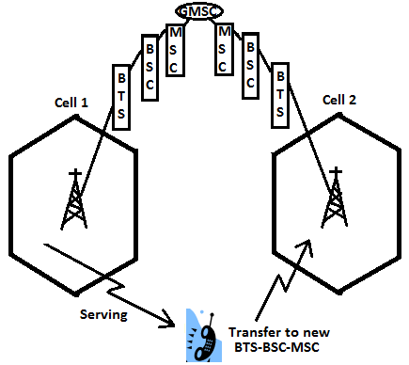
Types of Handoff
4) Inter MSC Handover :
The subscriber moves from cell1 to cell 2 which is served by another MSC.
In this case, handover
process is carried out by
the GMSC.
Traffic connection
with the first BTS-BSC-MSC
is released when the
connection with the new
BTS-BSC-MSC is setup
successfully.

Slide 22
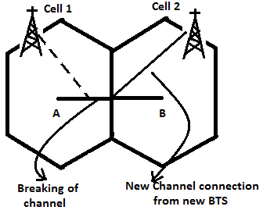
Classification of Handoff
Handoff can be classified as:
1) Hard Handoff
2) Soft Handoff
1) Hard Handoff :
Also known as Break Before Make.
It is one in which the channel in the source cell is released & only then the channel in the target cell is engaged.
Thus the connection to the source is broken before the connection to the target is made.
Hard handoffs are intended to be
instantaneous in order to minimize
the disruption to the call.
It is not necessary that there is
always a connection b/w base station
& mobile station.

Slide 23
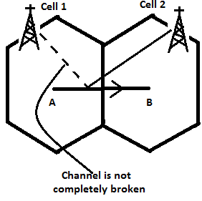
Classification of Handoff
2) Soft Handoff :
Also known as Make Before Break.
It is one in which the channel in the source cell is retained & used for a while in parallel with the channel in target cell.
Thus the connection to the target is established before the connection to the source is broken.
In this kind of handoff, there is
always a connection b/w base station
& mobile station.

Slide 24
Prioritizing Handoff / Guard Channel Concept
Here some of the channels of total available channels is reserved for handoff request from on-going calls which may be handed-off into the cell.
Guard channels however offer efficient spectrum utilization when dynamic channel assignment strategies, which minimize the number of required guard channels by efficient demand-based allocation are used.
Queuing of handoff request :
It is another method to decrease the probability of forced termination of calls due to lack of available channels.
Queuing of handoffs is possible due to the fact there is a finite time interval b/w the time the received signal level drops below the handoff threshold & the time the call is terminated due to insufficient signal level.

Slide 25
Practical Handoff Considerations
Problems occur because of a large range of mobile velocities
pedestrian vs. vehicle user
A pedestrian never requires handoff during the call, but if high speed user passes constantly b/w very small cells, MSC gets burdened quickly.
Small cell sizes and/or micro-cells → larger # handoffs
MSC load is heavy when high speed users are passed between very small cells
Umbrella Cells
use different antenna heights and Tx power levels to provide large and small cell coverage
multiple antennas & Tx can be co-located at single location if necessary (saves on obtaining new tower licenses)
large cell → high speed traffic → fewer handoffs
small cell → low speed traffic
example areas: interstate highway passing through urban center, office park, or nearby shopping mall

Slide 26
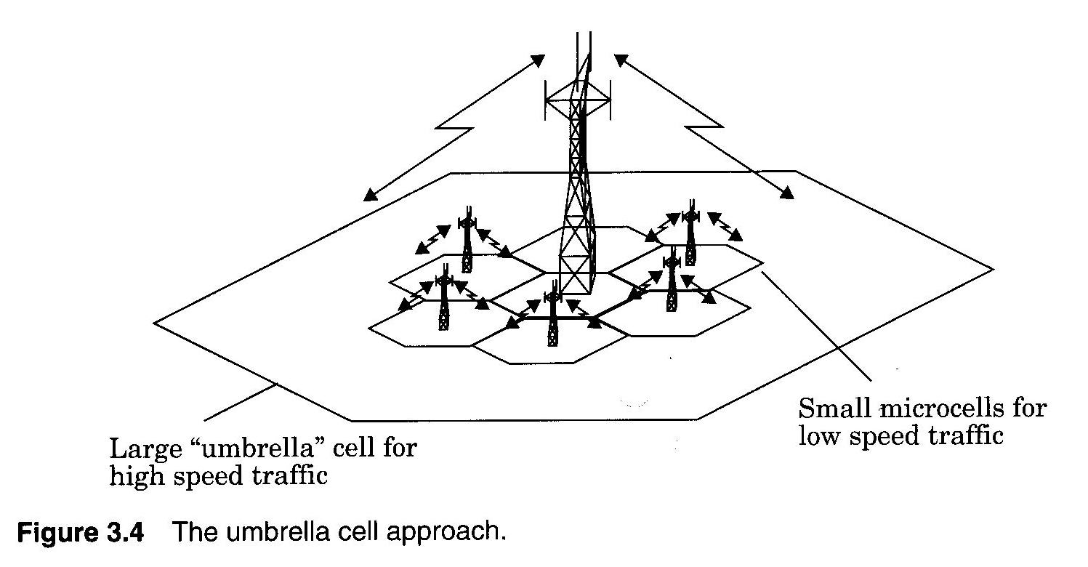
Umbrella Cells
Source : Wireless Communications: Principles and Practice, Theodore S. Rappaport, pp 67.

Slide 27
Typical handoff parameters
Analog cellular (1st generation)
threshold margin △ ≈ 6 to 12 dB
total time to complete handoff ≈ 8 to 10 sec
Digital cellular (2nd generation)
total time to complete handoff ≈ 1 to 2 sec
lower necessary threshold margin △ ≈ 0 to 6 dB
enabled by mobile assisted handoff

Slide 28
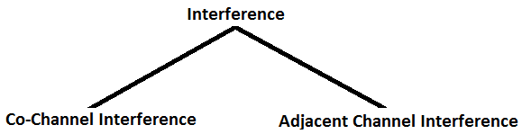
Interference & System Capacity
Source of interference :
Another mobile in the same cell.
A call in progress in a neighboring cell.
Other base stations operating in the same frequency band.
Any non-cellular system which inadvertently leaks energy into cellular frequency band.

Slide 29
Effects of Interference
Interference in voice channels causes
Crosstalk
Noise in background
Interference in control channels causes
Error in digital signaling, which causes
Missed calls
Blocked calls
Dropped calls

Slide 30
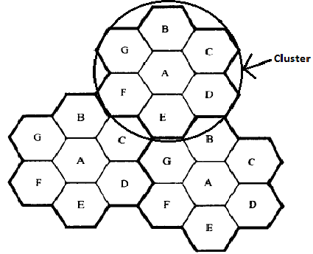
Interference & System Capacity
Co-Channel Interference & System Capacity :
Frequency reuse implies that in a given coverage area there are several cells that use the same set of frequencies. These cells are called Co-Channel cells & interference b/w signals from these cells is called Co-Channel Interference.
Unlike, thermal noise which can be overcome by increasing the SNR (signal-to-noise ratio), Co-Channel interference can not be combated by simply increasing the carrier power of a transmitter, because an increase in carrier transmit power increases the interference to neighboring co-channel cells.
To reduce co-channel interference, co-channel cells must be physically separated by a minimum distance to provide sufficient isolation due to propagation.
R 🡪 Radius of a cell
D 🡪 distance b/w centers of the nearest
co-channel cells.
Therefore by increasing the ratio D/R, separation
b/w co-channel cells relative to the coverage distance of a cell is increased. Thus interference is reduced.

Slide 31

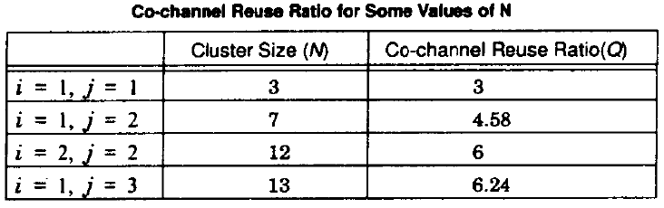
Interference & System Capacity
Q 🡪 Co-Channel Reuse ratio, is related to cluster size shown in table. For Hexagonal geometry
A small value of Q provides larger capacity, Since the cluster size N is small.
A large value of Q improves the Transmission Quality, Due to smaller level of co-channel interference.
Therefore a Trade-off must be made b/w these two objectives in actual cellular design.
Table Source : Wireless Communications: Principles and Practice, Theodore S. Rappaport, pp 69.

Slide 32
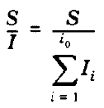
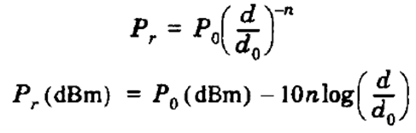
Interference & System Capacity
Let i_{o} be the number of co-channel interfering cells.
Then, the signal-to-interference ratio (S/I or SIR) for a mobile receiver which monitors a forward channel can be expressed as:
where S is the desired signal power from the desired base station & I is the interference power caused by the i^{th} interfering co-channel cell base station.
Average Power Received P_{r} at a distance d from the transmitting antenna is approximated by:
where P_{o} is the power received at a close-in reference point in the far field region of the antenna at a small distance d_{o} from the transmitting antenna & n is the path loss exponent.

Slide 33
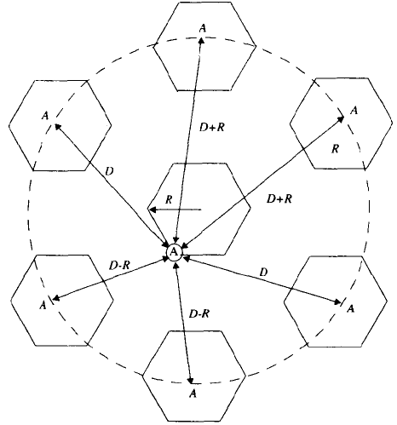

Interference & System Capacity
Now consider the forward link where the desired signal is the serving base station & where the interference is due to co-channel base station.
If D_{i} is the distance of the
i^{th} interfere from the mobile,
the received power at a given
mobile due to the i^{th} interfering
cell will be proportional to
(Di)^{-n} .
When transmit power of each
base station is equal & the path
Loss exponent is the same
throughout the coverage area,
S/I for a mobile can be approximated as:
---------(A)
Source : Wireless Communications: Principles and Practice, Theodore S. Rappaport, pp 71.

Slide 34


Interference & System Capacity
If the interfering base stations are equidistant from the desired base station & if this distance is equal to the distance D b/w cell centers, then
S/I relates to the cluster size N, which in turns determine the capacity of the system. From equation C= M.K.N.
For US, AMPS cellular system which uses FM & 30 kHz channels, subjective tests indicate that sufficient voice quality is provided when S/I is greater than or equal to 18dB.
In order to meet this requirement, the cluster size N should be at least 6.49 (=7), assuming path loss exponent n=4.
For a seven cell cluster, with the mobile unit at the cell boundary, the mobile is a distance D-R from the two nearest co-channel interfering cell & is exactly D+R/2, D, D-R/2 and D+R from the other interfering cells in the first tier.
S/I ratio for the worst case can be closely approximated as (n=4)

Slide 35

Interference & System Capacity
This equation can be rewritten in terms of the co-channel reuse ratio Q, as
-------(B)
For N=7, the co-channel reuse ratio Q is 4.6 and the worst case S/I is approximated as 49.56 (17dB) using equation (B), where as an exact solution using equation (A) yields 17.8dB. Hence for a seven-cell cluster, the S/I ratio is slightly less than 18dB for the worst case. To design the cellular system,

Slide 36
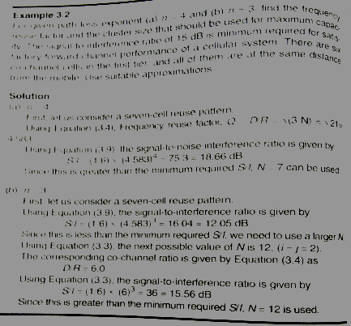
Problem
Source : Wireless Communications: Principles and Practice, Theodore S. Rappaport, pp 72.

Slide 37
Adjacent Channel Interference
Results from imperfect receiver filters, allowing nearby frequencies to leak into pass-band.
Can be minimized by careful filtering and channel assignments.
Channels are assigned such that frequency separations between channels are maximized.
For example, by sequentially assigning adjacent bands to different cells
Total 832 channels, divided into two groups with 416 channels each.
Out of 416, 395 are voice and 21 are control channels.
395 channels are divided into 21 subsets, each containing almost 19 channels, with closet channel 21 channels away
If N=7 is used, each cell uses 3 subsets, assigned in such a way that each channel in a cell is 7 channels away.

Slide 38
1
2
3
4
5
6
7
8
9
10
11
12
13
14
freq
B
2
9
G
C
4
5
11
12
A
1
8
F
D
6
7
13
14
E
3
10
Frequency Planning/Channel Assignment

Slide 39
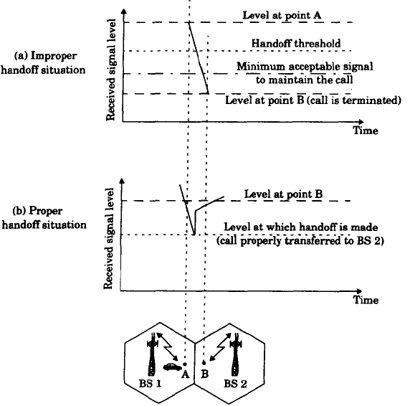
Handoff
.
Source : Wireless Communications: Principles and Practice, Theodore S. Rappaport, pp 63.

